Slide 1
Supervised Learning Networks
Prof. J. Ujwala Rekha

Slide 2
What is Perceptron?
Perceptron is one of the simplest ANN architecture.
It was introduced by Frank Rosenblatt in 1957
It is a feed forward neural network consisting of a single layer of input nodes that are fully connected to a layer of output nodes.
It can learn the linearly separable patterns.
It uses slightly different types of artificial neurons known as threshold logic units (TLU).

Slide 3
Types of Perceptrons
Single-Layer Perceptron: This type of perceptron is limited to learning linearly separable patterns.
Effective for tasks where the data can be divided into distinct categories through a straight line.
Multilayer Perceptron: Multilayer perceptron possesses enhanced processing capabilities and adept at handling more complex patterns and relationships within the data.

Slide 4
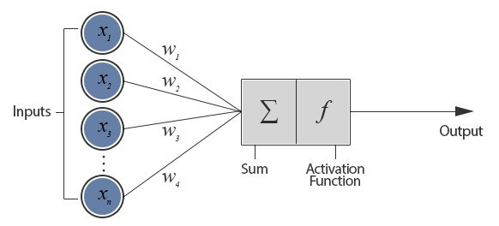
Basic Components of Perceptron

Slide 5
Basic Components of a Perceptron
Input Nodes or Input Layer: This is the primary component of Perceptron which accepts the initial data into the system for further processing.
Weight: Weight parameter represents the strength of connection between units. Weight is directly proportional to the strength of the associated input neuron in deciding the output.
Bias: It is the constant which is added to the product of features and weights. It is used to offset the result. It helps the models to shift the activation function towards the positive or negative side

Slide 6
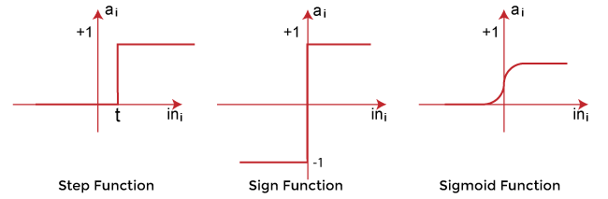
Basic Components of a Perceptron
Activation Function: It determines whether the neuron will fire or not.
Types of Activation Functions:

Slide 7
How Does a Perceptron Work?

Slide 8
How Does a Perceptron Work?

Slide 9
How Does a Perceptron Work?

Slide 10
Perceptron Learning Procedure
Here we describe what Rosenblatt defined as an error-corrective reinforcement learning procedure:
Compute the mismatch between the obtained value and the expected value for the training example
If the obtained and expected values match, do nothing
If the obtained and expected values do not match, compute the difference or delta between those values
Use the delta value to update the weights of the network

Slide 11
Perceptron Learning Procedure

Slide 12
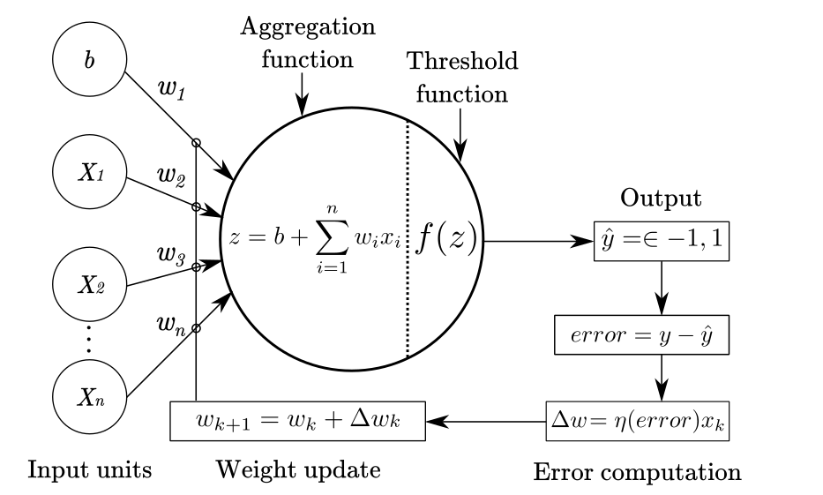
Schematic Representation of the Perceptron with the Learning Procedure

Slide 13
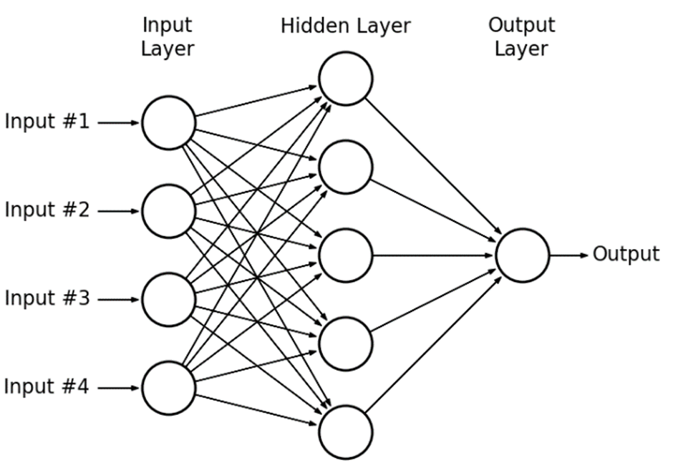
Multilayer Perceptron

Slide 14
Limitations of Perceptron Model
The output of a perceptron can only be a binary number due to the hard limit transfer function.
Perceptron can only be used to classify the linearly separable sets of input vectors.

Slide 15
ADALINE (Adaptive Linear Neuron)
The ADALINE was introduced shortly after Rosenblatt’s perceptron by Bernard Widrow and Ted Hoff.
The main difference between the perceptron and the ADALINE is that the later works by minimizing the mean-squared error of the predictions of a linear function.
This means that the learning procedure is based on the outcome of a linear function rather than on the outcome of a threshold function as in the perceptron.

Slide 16
ADALINE (Adaptive Linear Neuron)
Mathematically, learning from the output of a linear function enables the minimization of a continuous cost or loss function.
The cost function is a measure of the overall badness (or goodness) of the network prediction.

Slide 17
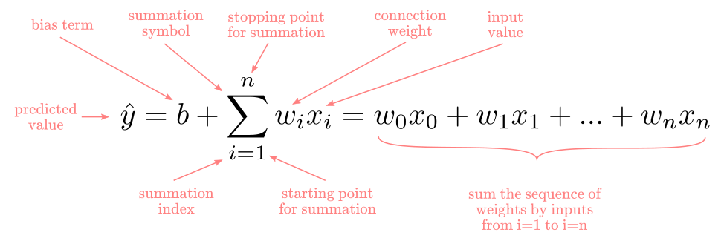
ADALINE-Mathematical Formalization
Mathematically, the ADALINE is described by:
A linear function that aggregates the input signal
A learning procedure to adjust connection weights
The linear aggregation function is the same as in the perceptron:

Slide 18
ADALINE-Threshold Decision Function

Slide 19
Perceptron Vs. ADALINE

Slide 20
Perceptron Vs. ADALINE
It means that the ADALINE can learn even when no classification mistake has been made.
Since the ADALINE learns all the time and the perceptron only after errors, the ADALINE will find a solution faster than the perceptron for the same problem.

Slide 21
The ADALINE Error Computation

Slide 22
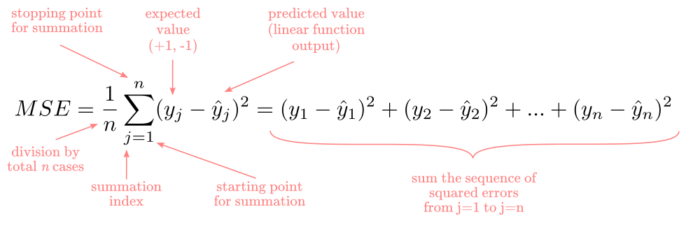
The ADALINE Error Computation

Slide 23
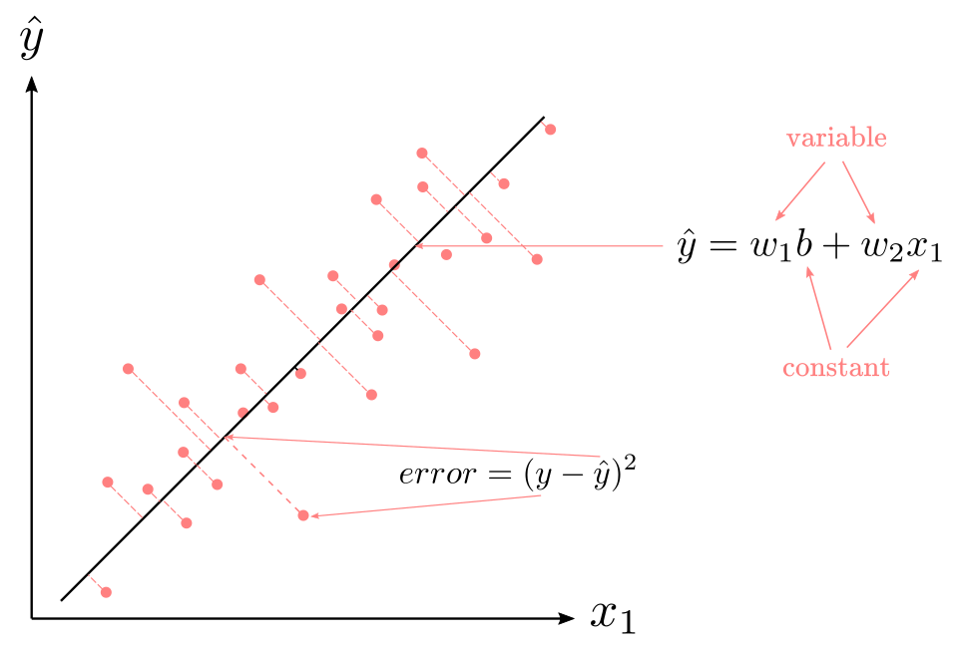
The ADALINE Error Surface
Fig. Visual Example of Least Squares Method with One Predictor

Slide 24
The ADALINE Error Surface

Slide 25
The ADALINE Error Surface

Slide 26
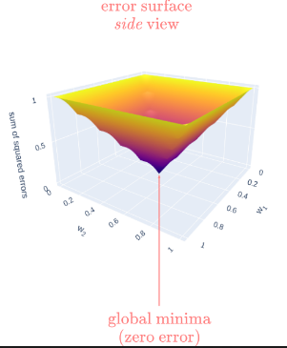
The ADALINE Error Surface

Slide 27
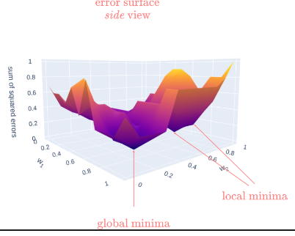
The ADALINE Error Surface
Instead, of having a unique point where the error is at its minima, we have multiple low points or valleys at different sections in the surface.
Those valleys are called local minima.
Ideally, we want to find the global minima.

Slide 28
ADALINE Learning Procedure
We want to find a set of parameters that minimize the mean of squared errors.
The ADALINE approaches this by utilizing the gradient descent algorithm.
Imagine that you are hiker at the top of a mountain in the side of a valley similar the figure in the previous slide.
Your goal is to reach the base of the valley. Logically, you would want to walk downhill.
In the context of training neural networks, this is what we call “descending a gradient”.
We want to follow the pat that will get you faster to the base of the valley.
In gradient descent terms, this equals to move along the error surface in the direction where the gradient (degree of inclination) is steepest.
We can use the chain-rule of calculus to estimate the gradient and adjust the weights.

Slide 29
ADALINE Learning Procedure

Slide 30
ADALINE Learning Procedure

Slide 31
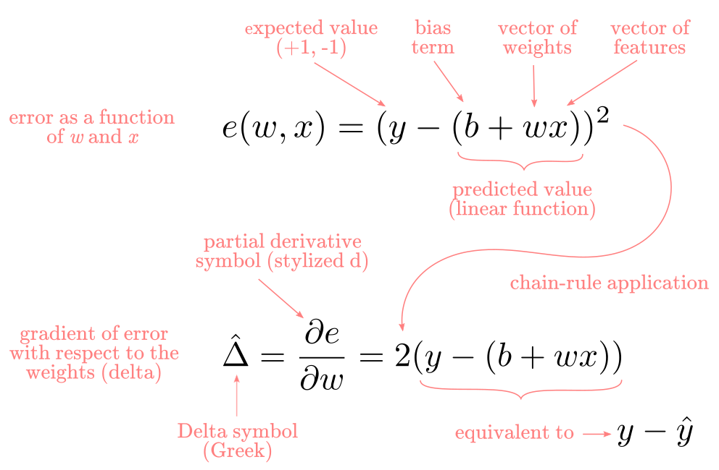
ADALINE Learning Procedure

Slide 32
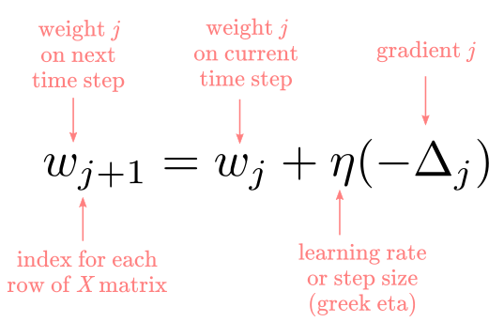
ADALINE Learning Procedure

Slide 33
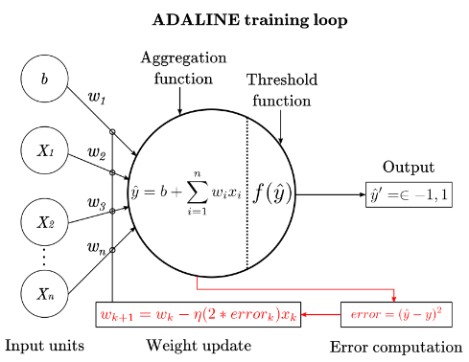
Schematic Representation of the ADALINE with the Learning Procedure

Slide 34
Thank You

